Slide 1
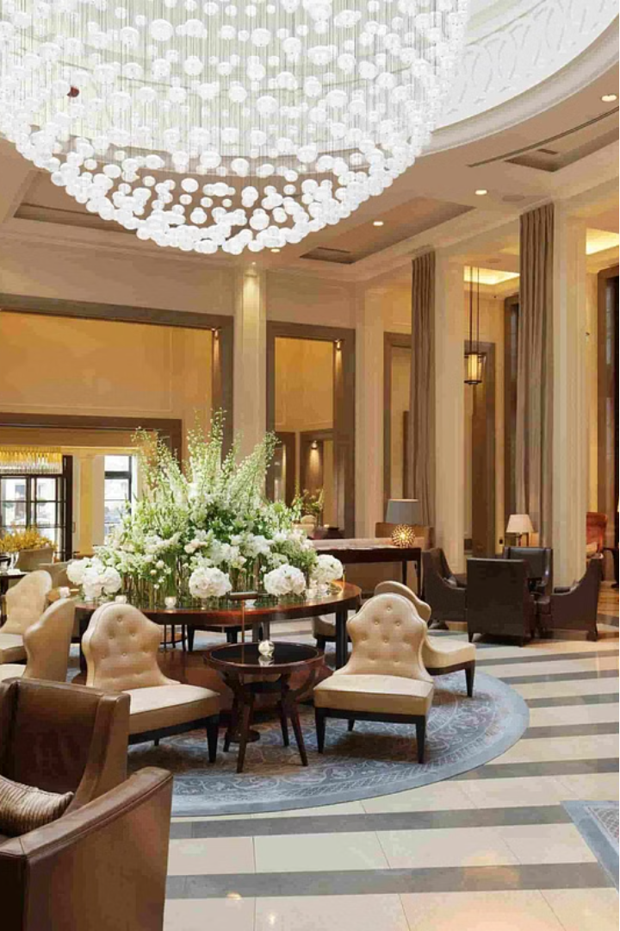

Reducing Hotel Booking Cancellations
Business Problem:
In recent years, City Hotel and Resort Hotel have experienced high cancellation rates. Each hotel is now grappling with a number of issues as a result, including reduced revenues and suboptimal room utilization. Consequently, decreasing cancellation rates is both hotels' primary objective in order to enhance their efficiency in revenue generation. Our goal is to provide comprehensive business recommendations to address this issue.
The focus of this report is the analysis of hotel booking cancellations and other factors that impact their operations and annual revenue generation.
Ga
by Goutam Kuiri

Slide 2

Hotel Booking Cancellations: Key Assumptions and Insights
1
Assumptions
No unusual changes between 2015-2017
The data and information are still valid
No hidden problems with suggested ideas
Hotels haven't implemented these ideas yet
Cancellations impact revenue the most
Canceled rooms remain unoccupied
Customers reserve and cancel in the same year
2
Research Questions
What factors influence hotel booking cancellations?
How can we improve the cancellation process?
How can hotels get assistance with pricing and promotions?
3
Hypotheses
More cancellations when prices are high
Cancellations likely if long waitlist
Most book through travel agents, not online

Slide 3

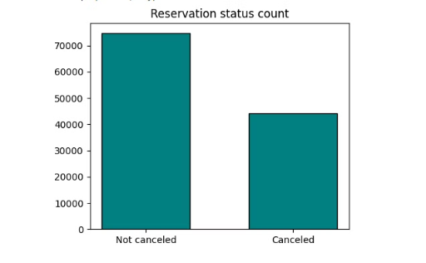
Data Analysis and Visualizations
Calculating the percentage of canceled and non-canceled bookings
We calculated the percentage of both canceled and non-canceled bookings based on the provided data. Our analysis reveals that 62.87% of bookings remain non-canceled, while 37.13% have been canceled. This indicates a substantial portion of reservations experiencing cancellation, highlighting the potential impact on hotel operations and revenue. Understanding these percentages allows for a deeper comprehension of booking trends and aids in strategic decision-making for hotel management.

Slide 4

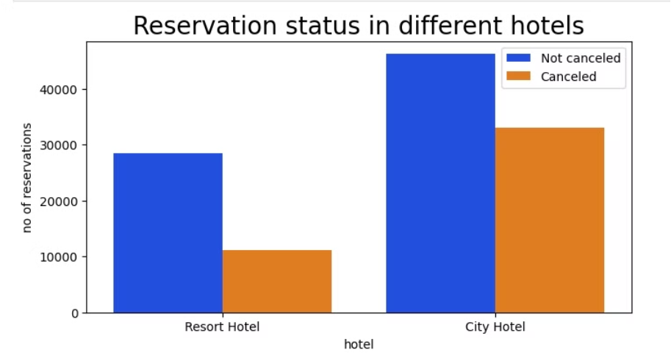
Visualize the Reservation status across different hotels
In comparison to city hotels, resort hotels have fewer bookings. It's possible that resort hotels are pricier than those in urban areas.
In resort hotels, most bookings, about 72%, aren't canceled. However, around 27.9% of reservations are getting canceled, which is still quite a sizable portion.
City hotels are facing a high cancellation rate, with 41.7% of reservations getting canceled, while only 58.2% are staying confirmed.

Slide 5
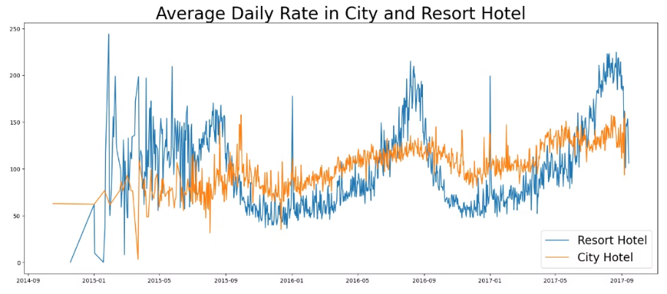
Calculating the average daily rate for Resort Hotel and City Hotel
The slide shows a visualization comparing the average daily rate (ADR) between city hotels and resort hotels over time.
The orange line represents the ADR for city hotels, while the blue line represents the ADR for resort hotels.
We can see that the lines intersect at various points, indicating that the price comparison between the two hotel types fluctuates over time.
Generally, city hotel prices tend to be lower than resort hotel prices, except during busy periods like holidays and weekends when demand increases and prices rise.
This supports our hypothesis that city hotel ADR is typically lower than resort hotel ADR, with some exceptions during peak travel times.
The visualization provides a clear, data-driven way to illustrate this trend and support our analysis.
Notes:
The slide shows a visualization comparing the average daily rate (ADR) between city hotels and resort hotels over time. The orange line represents the ADR for city hotels, while the blue line represents the ADR for resort hotels. We can see that the lines intersect at various points, indicating that the price comparison between the two hotel types fluctuates over time. Generally, city hotel prices tend to be lower than resort hotel prices, except during busy periods like holidays and weekends when demand increases and prices rise. This supports our hypothesis that city hotel ADR is typically lower than resort hotel ADR, with some exceptions during peak travel times. The visualization provides a clear, data-driven way to illustrate this trend and support our analysis.

Slide 6

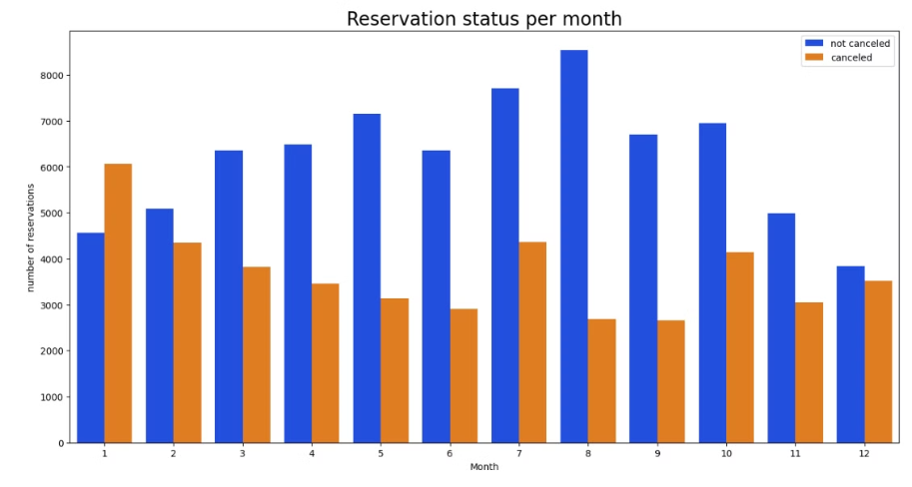
Determining the Reservation status per month
January saw the highest rate of cancellations, while August had the lowest cancellation rate.
August had the most reservations, while December and January had the fewest.
These trends in reservation status and cancellations are important to understand seasonal patterns in demand.
Knowing when peak and low seasons occur can help us optimize staffing, inventory, and other operational decisions.
Analyzing these monthly fluctuations will allow us to better prepare for and respond to changes in reservation volume.
Notes:
January saw the highest rate of cancellations, while August had the lowest cancellation rate. August had the most reservations, while December and January had the fewest. These trends in reservation status and cancellations are important to understand seasonal patterns in demand. Knowing when peak and low seasons occur can help us optimize staffing, inventory, and other operational decisions. Analyzing these monthly fluctuations will allow us to better prepare for and respond to changes in reservation volume.

Slide 7
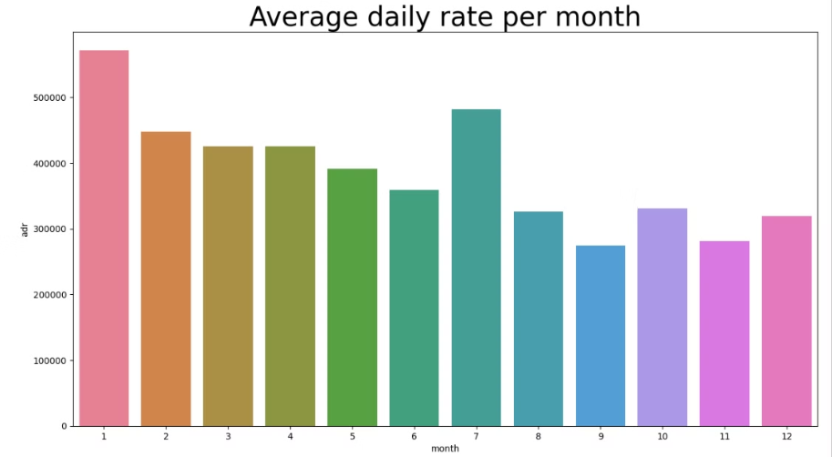
Calculated the average daily rate per month to assess price fluctuations in relation to cancellations
The data analysis revealed that January had the highest cancellation rate and highest average daily rate, while August had the lowest cancellation rate and lower prices.
• August was the busiest month for bookings, while December and January were slower periods.
• There appears to be a clear relationship between cancellation rates and pricing - higher prices tend to coincide with increased cancellations, while lower prices correspond to decreased cancellation rates.
• This finding highlights the importance of pricing strategies in effectively managing reservation cancellations.
• The insights from this analysis can inform pricing decisions to balance occupancy, revenue, and cancellation rates.
Notes:
• The data analysis revealed that January had the highest cancellation rate and highest average daily rate, while August had the lowest cancellation rate and lower prices. • August was the busiest month for bookings, while December and January were slower periods. • There appears to be a clear relationship between cancellation rates and pricing - higher prices tend to coincide with increased cancellations, while lower prices correspond to decreased cancellation rates. • This finding highlights the importance of pricing strategies in effectively managing reservation cancellations. • The insights from this analysis can inform pricing decisions to balance occupancy, revenue, and cancellation rates.

Slide 8
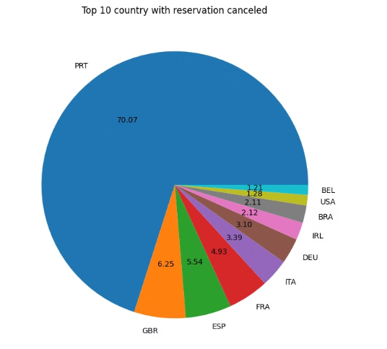
Determining the cancellation percentage across various countries.
Portugal has the highest cancellation rate at 70.07%, significantly higher than the second highest rate of 6.25% in the United Kingdom.
• This stark difference suggests Portugal should consider enhancing its facilities, adjusting pricing strategies, offering more discounts, and running promotional campaigns to reduce the high cancellation rate.
• Improving the customer experience through upgraded amenities and better services can make stays more appealing, thereby reducing cancellations.
• Revisiting pricing models to be more competitive and attractive, coupled with targeted discounts and special offers, can incentivize more bookings and minimize cancellations.
• Effective marketing campaigns can further bolster these efforts by attracting a more committed customer base.
• By addressing these areas, Portugal can work towards aligning its cancellation rates more closely with other countries, stabilizing and potentially increasing its reservation rates.
Notes:
• Portugal has the highest cancellation rate at 70.07%, significantly higher than the second highest rate of 6.25% in the United Kingdom. • This stark difference suggests Portugal should consider enhancing its facilities, adjusting pricing strategies, offering more discounts, and running promotional campaigns to reduce the high cancellation rate. • Improving the customer experience through upgraded amenities and better services can make stays more appealing, thereby reducing cancellations. • Revisiting pricing models to be more competitive and attractive, coupled with targeted discounts and special offers, can incentivize more bookings and minimize cancellations. • Effective marketing campaigns can further bolster these efforts by attracting a more committed customer base. • By addressing these areas, Portugal can work towards aligning its cancellation rates more closely with other countries, stabilizing and potentially increasing its reservation rates.

Slide 9
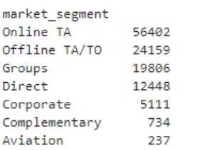
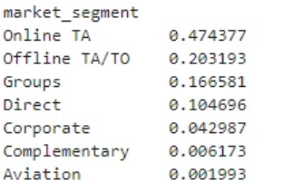
Analyzing Market Segments
Online TA is the largest segment with 56402 bookings. This suggests a strong presence and effectiveness of online travel agencies in driving reservations.
Offline TA/TO is the second largest segment with 24159 bookings. This suggests a robust influence and effectiveness of traditional travel agencies and tour operators in driving reservations.
The data shows the continued importance of both online and offline channels in the travel industry.
Analyzing Market Segments Proportionally
Online TA constitutes 47.4% of the bookings, showing a strong reliance on online travel agencies for reservations.
Notes:
• La mayor parte de las reservas, más de 56,000, se realizaron a través de agencias de viajes en línea, lo que indica su fuerte presencia y efectividad para impulsar las reservas. • Las agencias de viajes tradicionales y los operadores turísticos son el segundo segmento más grande, con más de 24,000 reservas, lo que sugiere que aún tienen una influencia y efectividad sólidas a la hora de impulsar las reservas. • Los datos muestran la continua importancia de los canales tanto en línea como fuera de línea en la industria de los viajes. • Tendremos que analizar más a fondo las tendencias y dinámicas dentro de cada uno de estos segmentos clave del mercado para entender cómo llegar y atender mejor a los clientes.

Slide 10
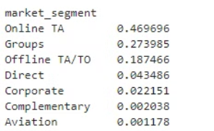
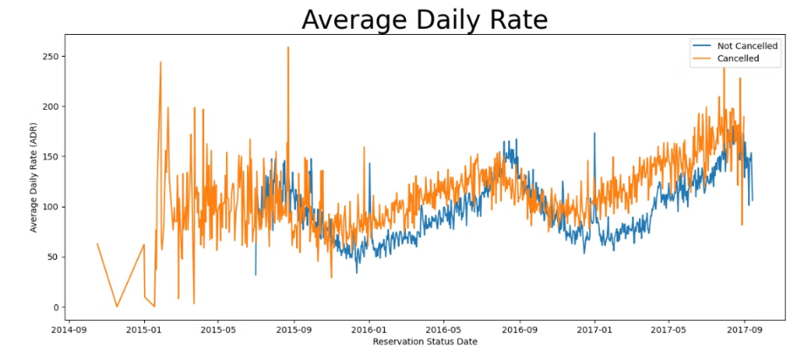
Analyzing Cancellation Rates by Market Segment
Online TA constitutes 46.9% of the cancellations, indicating that a majority of cancellations come from online travel agencies.
Recommendations
Address Online TA Cancellations: Since Online TA has the highest proportion of cancellations, consider reviewing and potentially tightening the cancellation policies associated with these bookings. Enhance customer engagement and support for online bookings to reduce cancellations.
The chart indicates that cancellations occur more frequently when the average daily rate is higher compared to when it is lower. This clearly supports the previous analysis, demonstrating that increased prices lead to a higher rate of cancellations.
Notes:
• Online travel agencies account for nearly half of all cancellations, so this is a key area for us to focus on. • We should review the cancellation policies for online bookings and consider tightening them to discourage unnecessary cancellations from this channel. • At the same time, we need to enhance our customer engagement and support for online bookings. This will help address any legitimate reasons customers have for cancelling and reduce the overall cancellation rate from this channel. • Addressing the high cancellation rate from online travel agencies is a critical priority, as it represents the largest source of cancellations for our business.

Slide 11
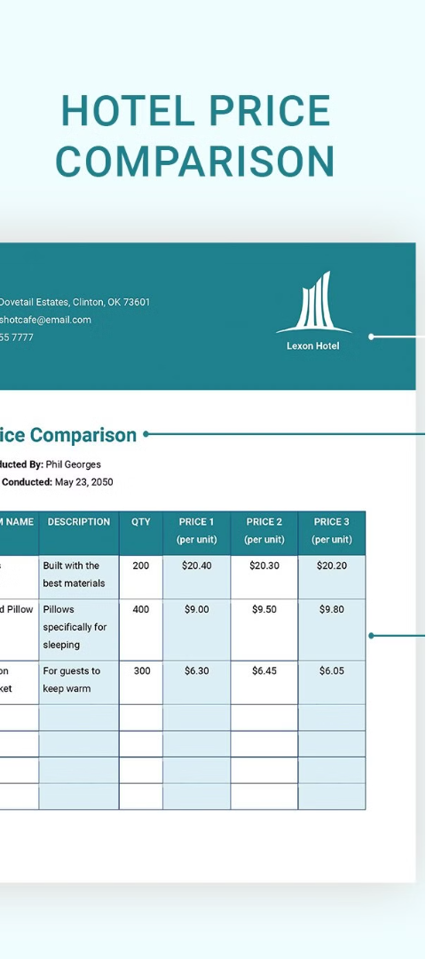
Pricing and Cancellation Relationship
1
High Prices, High Cancellations
Our findings suggest a clear relationship between cancellation rates and pricing dynamics - higher prices tend to coincide with increased cancellations, whereas lower prices correspond to decreased cancellation rates.
2
Pricing Strategies
Revisiting pricing models to make them more competitive and attractive, coupled with targeted discounts and special offers, can incentivize more bookings and minimize the likelihood of cancellations.
3
Promotional Campaigns
Effective marketing campaigns can further bolster these efforts by attracting a more committed customer base and reducing the high cancellation rate, particularly in markets like Portugal.

Slide 12
Booking Channel Insights
Online Travel Agencies
Traditional Travel Agencies
Customer Engagement
Online TA is the largest segment with 56,402 bookings, constituting 47.4% of the total. However, Online TA also accounts for 46.9% of the cancellations, indicating a need to review and potentially tighten the cancellation policies associated with these bookings.
Enhancing customer engagement and support for online bookings could help reduce cancellations from this dominant channel.
Offline TA/TO is the second largest segment with 24,159 bookings, suggesting a robust influence and effectiveness of traditional travel agencies and tour operators in driving reservations.

Slide 13

Improving Resort Hotel Performance
1
Competitive Pricing
2
Targeted Campaigns
Resort hotels should offer reasonable discounts on room prices during weekends or holidays to reduce the higher ratio of cancellations to non-cancellations compared to city hotels.
In January, when hotels experience the highest cancellation rates, they can initiate marketing campaigns with reasonable budgets to boost revenue.
3
Service Enhancements
Enhancing the quality of hotels and services, particularly in Portugal, could help decrease the high cancellation rate observed in that market.

Slide 14




Optimizing City Hotel Performance
Competitive Pricing
Targeted Discounts
Effective Marketing
City hotels should consider adjusting their pricing strategies and lowering rates for specific locations to reduce the impact of higher prices on cancellation rates.
Offering discounts to customers could be beneficial in incentivizing bookings and minimizing the likelihood of cancellations.
Implementing effective marketing campaigns can attract a more committed customer base and further support efforts to reduce cancellations.

Slide 15
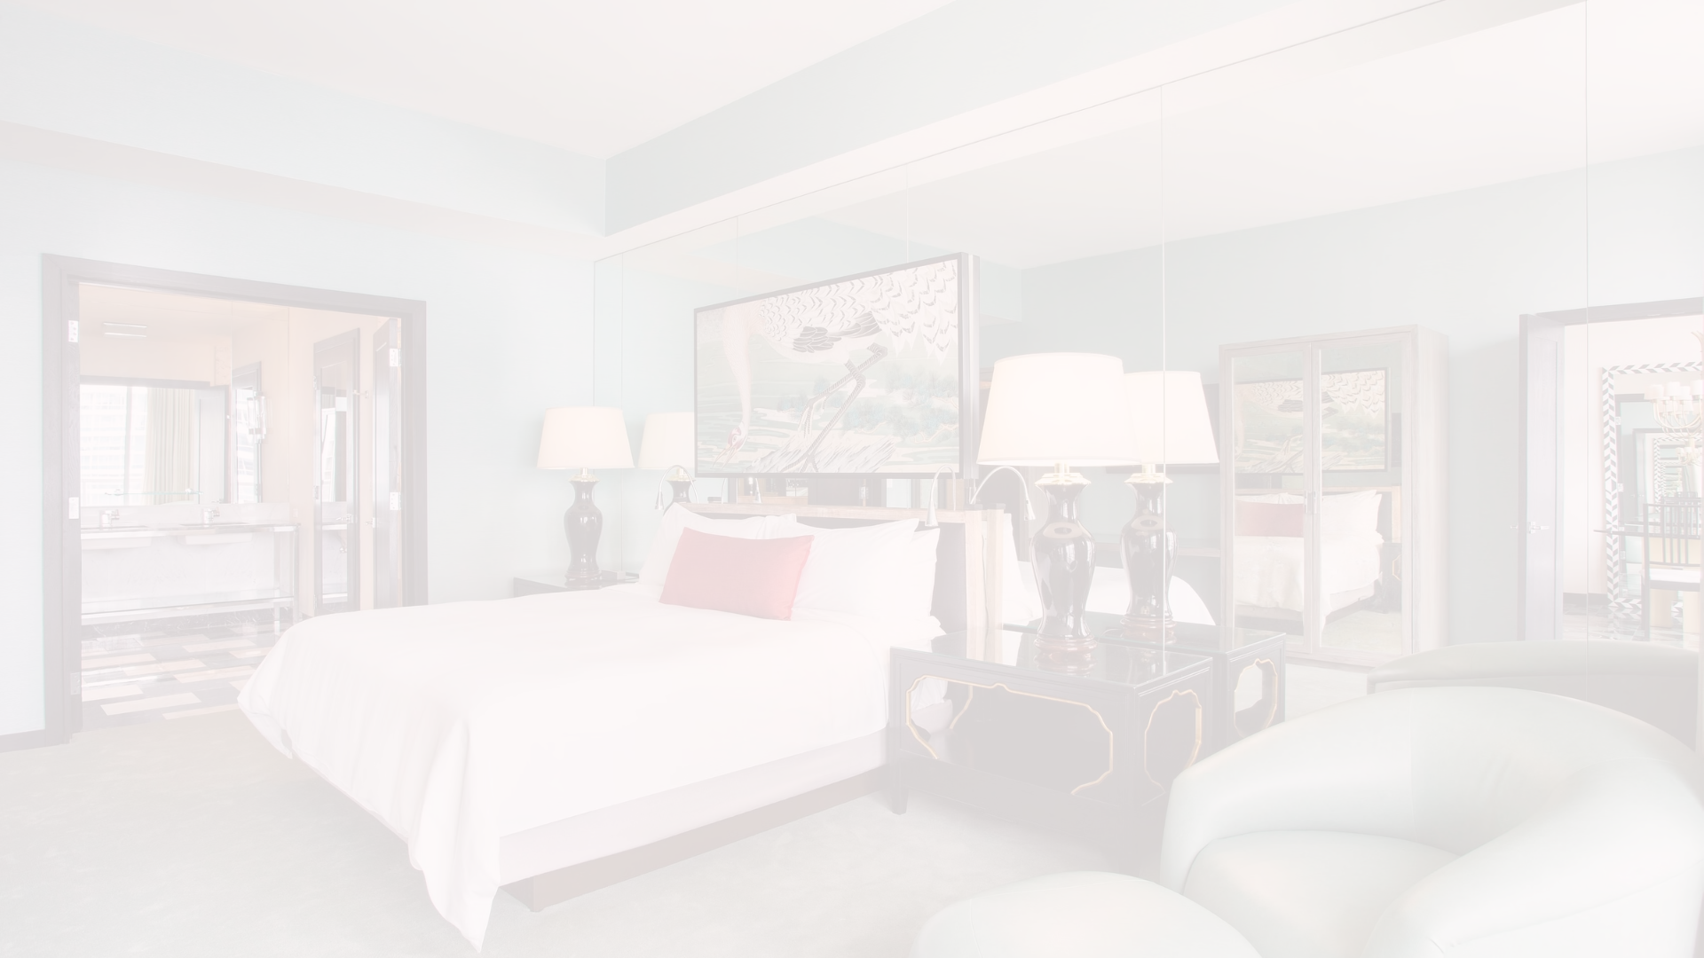



Enhancing the Customer Experience
Upgraded Amenities
Competitive Pricing
Targeted Discounts
Improving the customer experience through upgraded amenities and better services can make stays more appealing, thereby reducing cancellations.
Revisiting pricing models to make them more competitive and attractive can incentivize more bookings and minimize the likelihood of cancellations.
Offering targeted discounts and special offers can further enhance the appeal of hotel stays and reduce the risk of cancellations.

Slide 16
Addressing High Cancellation Rates in Portugal
Facility Upgrades
Pricing Strategies
With the highest cancellation rate at 70.07%, Portugal should consider enhancing its hotel facilities to make stays more appealing and reduce cancellations.
Adjusting pricing strategies, such as offering more discounts, can help make hotel stays in Portugal more attractive and reduce the high cancellation rate.
Promotional Campaigns
Customer Experience
Running targeted promotional campaigns can further bolster efforts to attract a more committed customer base and stabilize reservation rates in Portugal.
Improving the overall customer experience through better services and amenities can also contribute to reducing the high cancellation rate in Portugal.

Slide 17
Leveraging Data Insights
Insight
Recommendation
Cancellation rates increase as prices rise
Adjust pricing strategies and offer discounts to reduce cancellations
Resort hotels have higher cancellation-to-non-cancellation ratio
Offer reasonable discounts on room prices during weekends or holidays
January has the highest cancellation rates
Initiate marketing campaigns with reasonable budgets to boost revenue
Portugal has the highest cancellation rate
Enhance facilities, adjust pricing, offer discounts, and run promotional campaigns

Slide 18
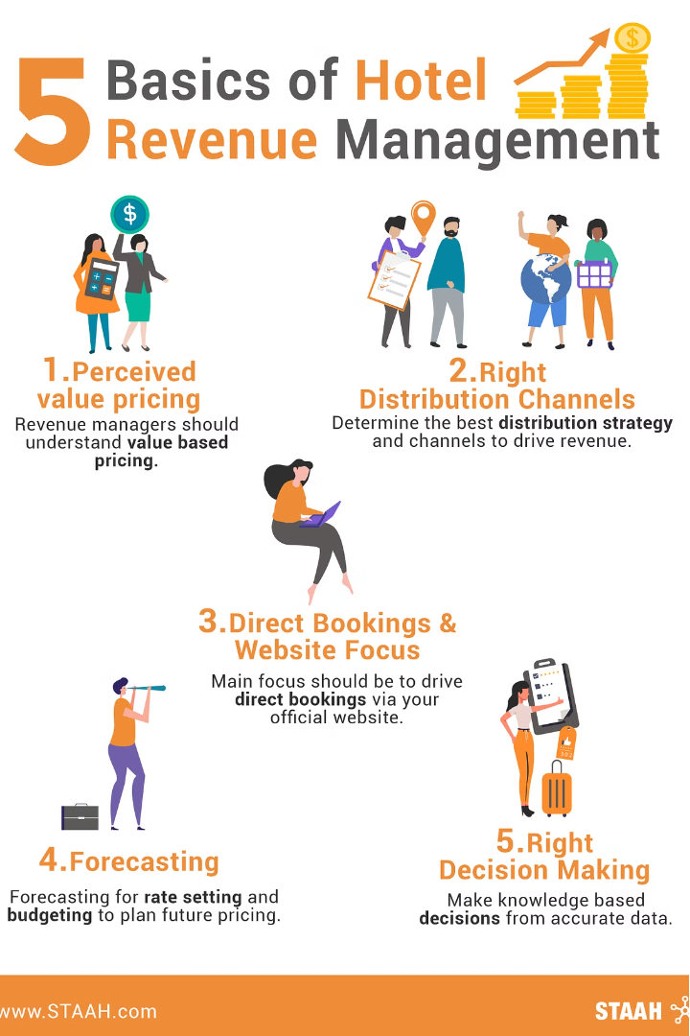
Suggestions
1.Cancellation rates increase as prices rise. To reduce reservation cancellations, hotels should consider adjusting their pricing strategies and lowering rates for specific locations. Additionally, offering discounts to customers could be beneficial.
2.The ratio of cancellations to non-cancellations is higher for resort hotels compared to city hotels. Therefore, resort hotels should offer reasonable discounts on room prices during weekends or holidays.
3.In January, hotels can initiate marketing campaigns with reasonable budgets to boost revenue, as this month experiences the highest cancellation rates.
4.Enhancing the quality of hotels and services, particularly in Portugal, could help decrease the cancellation rate.

